Slide 1
CO227 PROJECT MID EVALUATION
FINITE ELEMENT BASED
STRUCTURAL ANALYSIS

Slide 2
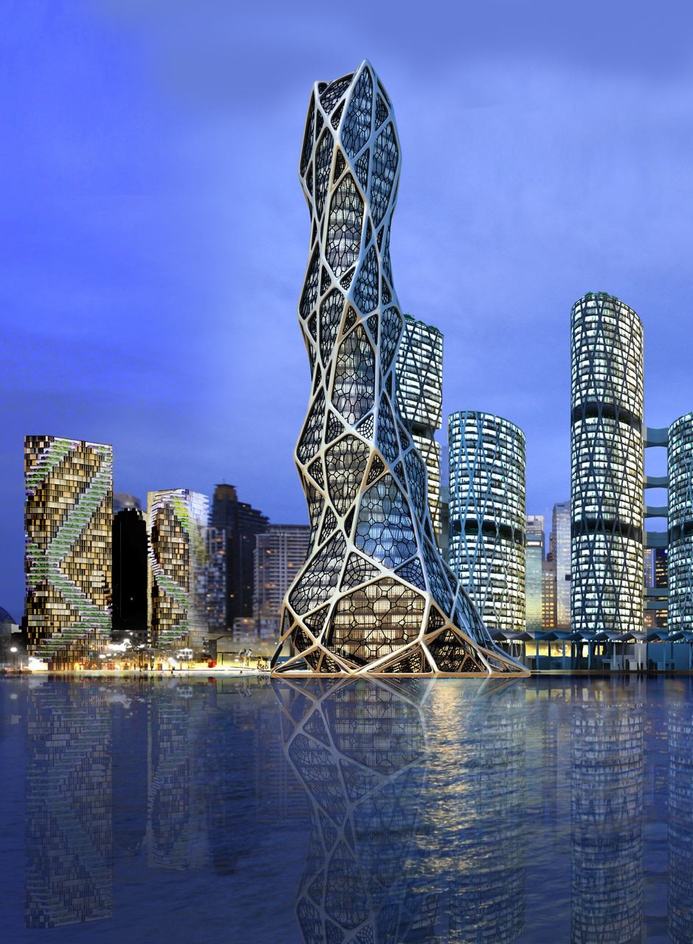
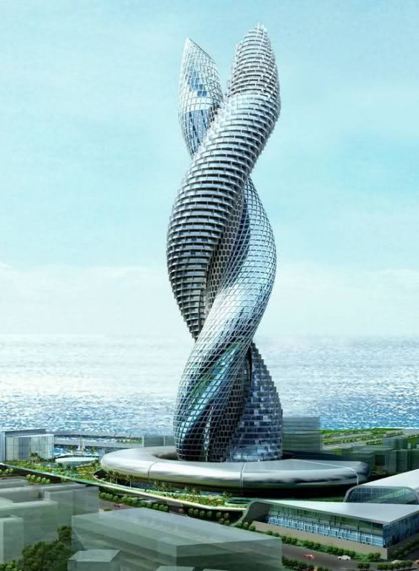
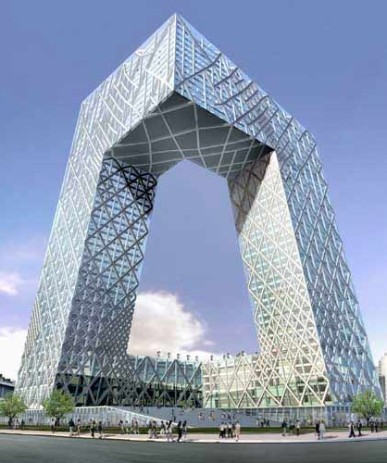
WHAT YOU SEE
Bionic tower, Abu Dhabi
Cobra tower, Kuwait
CCTV Headquarters, China

Slide 3
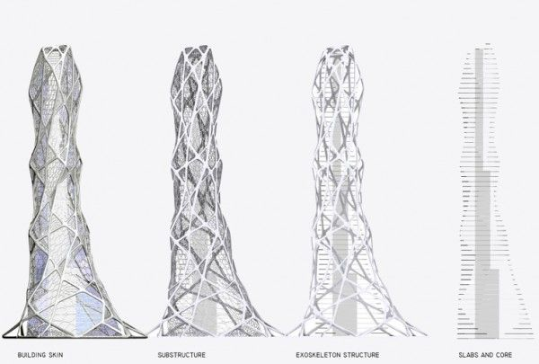
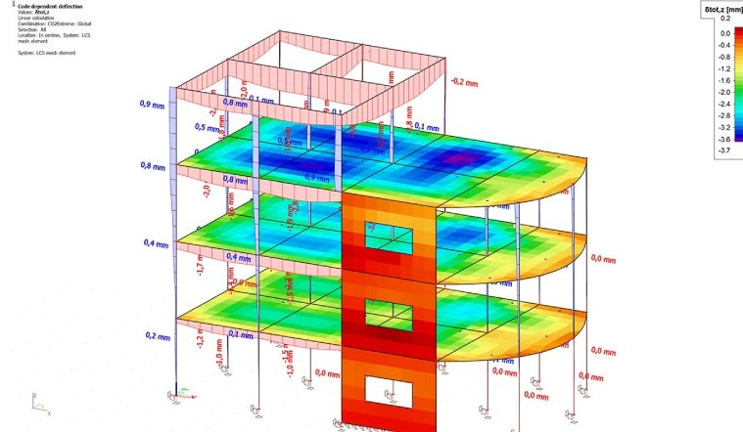
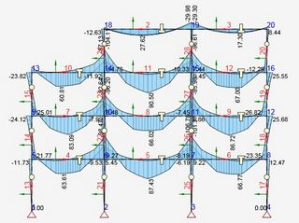
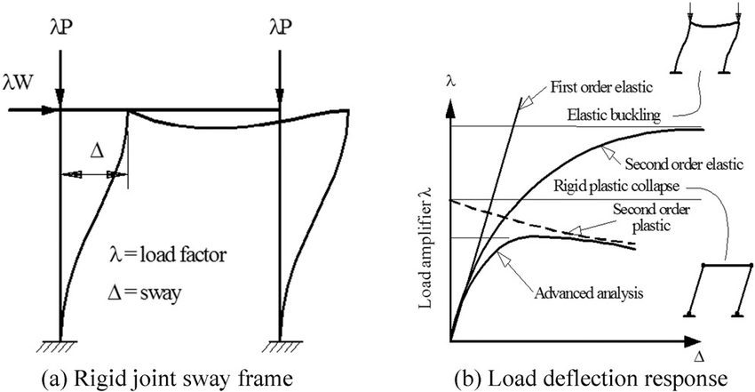
WHAT STRUCTURAL ENGINEERS SEE

Slide 4
HOW COMPLEX ?

Slide 5


LINEAR
NON-LINEAR
F = K e
K is Constant
Small loading conditions
K Varies
Extreme loading conditions
Widely used software : SAP 2000
Widely used software : Opensees

Slide 6
Interaction of
Axial force - Bending moment

Slide 7
Using the novel formulation developed by
the Department of Civil Engineering
Interaction of
Axial force - Bending moment - Shear force

Slide 8
A SIMPLE OVERVIEW
OF THE SOFTWARE

Slide 9
Nodes
Beams
Columns
Simple 3 story building using reinforced concrete frames

Slide 10
Degrees of freedom
z
m
x
y
Structure Level
Element Level

Slide 11
Concrete
Fibers
Steel
Fibers
Element
Section Level
Fiber Level

Slide 12
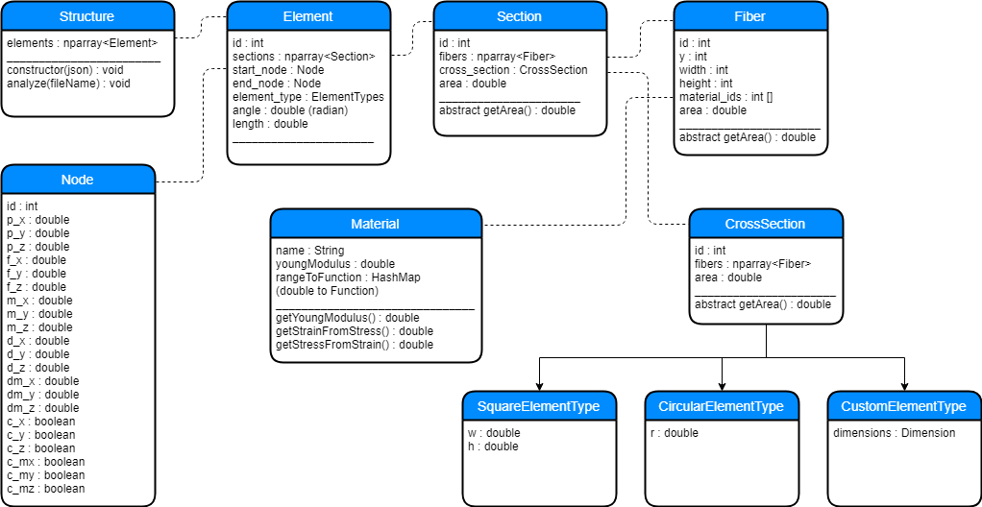
CLASS DIAGRAM

Slide 13
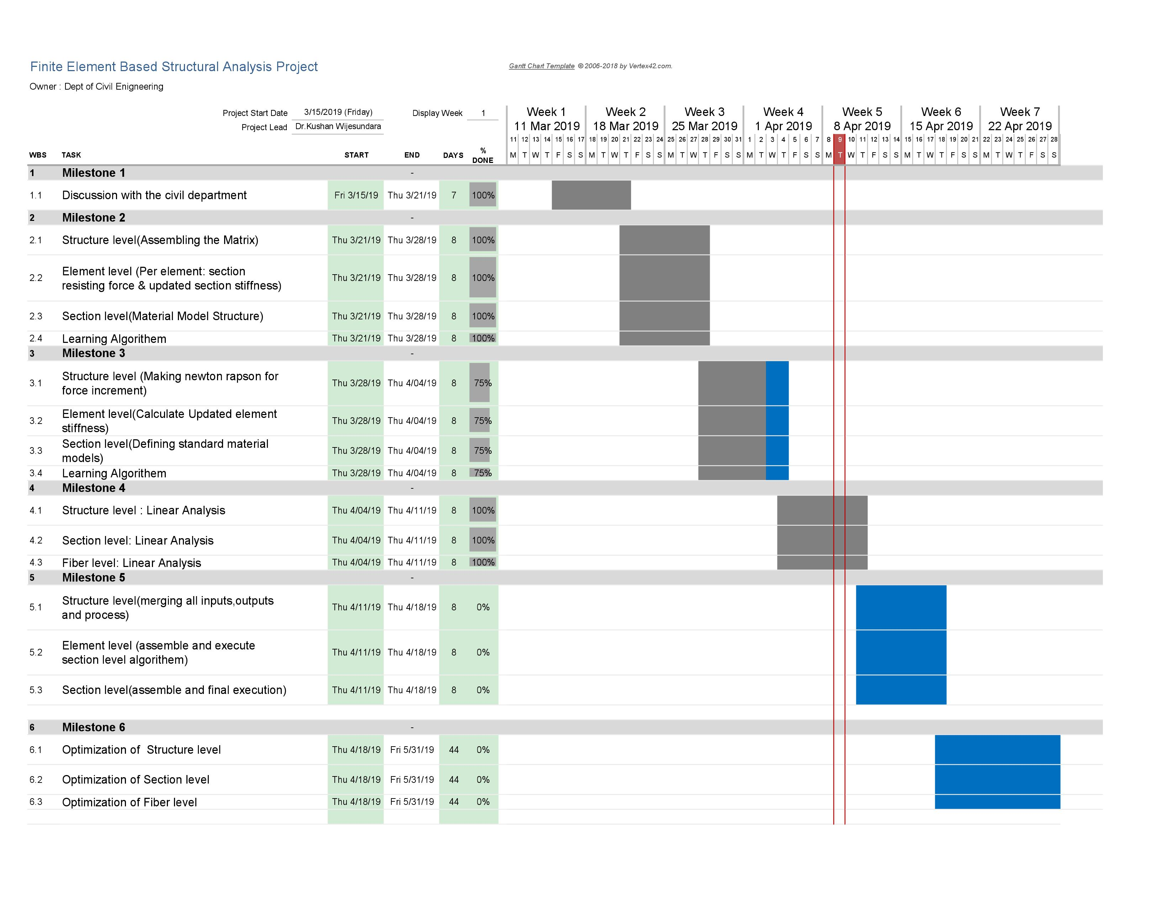
PROJECT PLAN AND PROGRESS

Slide 14
PROJECT PLAN AND PROGRESS

Slide 15
DEMONSTRATION

Slide 16
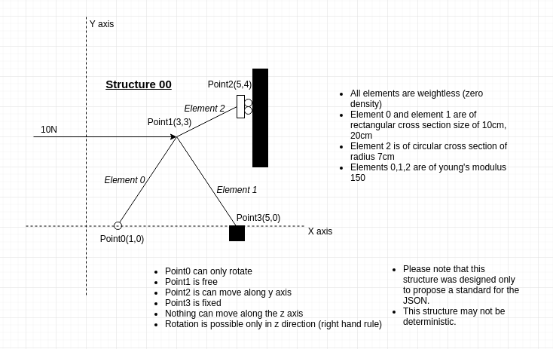
STRUCTURE WE ARE GOING TO ANALYZE

Slide 17
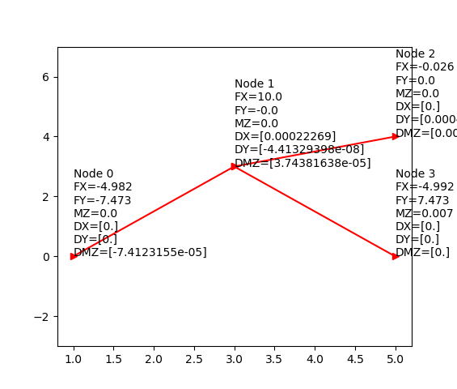
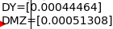
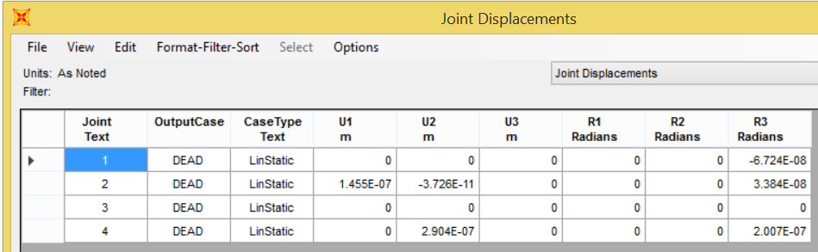
RESULTS COMPARISON
Displacements
SAP2000
Our results

Slide 18
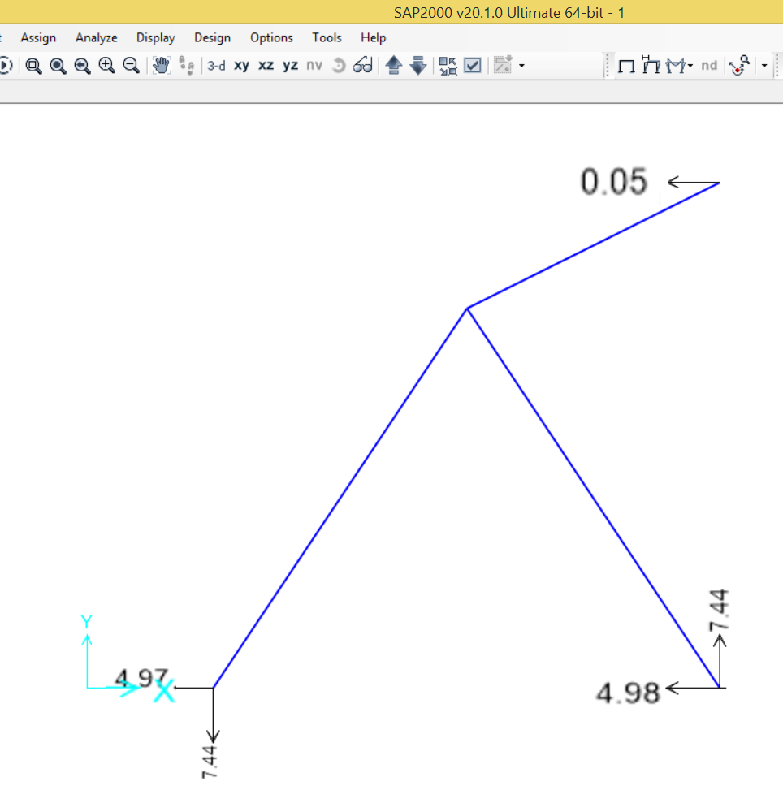
RESULTS COMPARISON
Forces
SAP2000
Our results

Slide 19
NEXT STEPS
Improvements
- Extending for 3D structures
Optimizations
- Parallelizing calculations
- GPU processing

Slide 20
Q & A

